Slide 1

The 2019 Stack Overflow Developer Survey Results
Tenzin Tsundue
February 6 2022

Slide 2

OUTLINE
Executive Summary
Introduction
Methodology
Results
Visualization – Charts
Dashboard
Discussion
Findings & Implications
Conclusion
Appendix

Slide 3

EXECUTIVE SUMMARY
Online survey of software professionals by stack overflow is examined
Most popular language and DB: JAVA and MYSQL
Most popular language and DB wanted to be learn next year: JAVA and PostgresSQL
95% Male and 5% Female
Age group 25-30

Slide 4

INTRODUCTION
Stack Overflow’s annual Developer Survey is the largest and most comprehensive survey of people who code around the world
Nearly 90,000 participant
This analysis examines popularity of different languages and databases.
Also age and gender of participants analyzed.

Slide 5

METHODOLOGY
Based on a survey of 88,883 software developers from 179 countries
The dataset comes from the following sources
The dataset used is a randomized subset contains around 1/10th of the original dataset and available as a .csv file here.

Slide 6
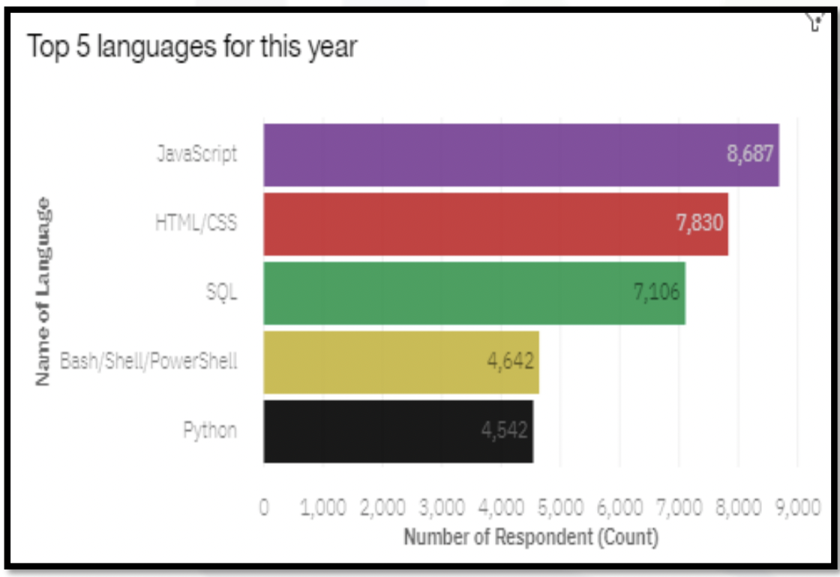
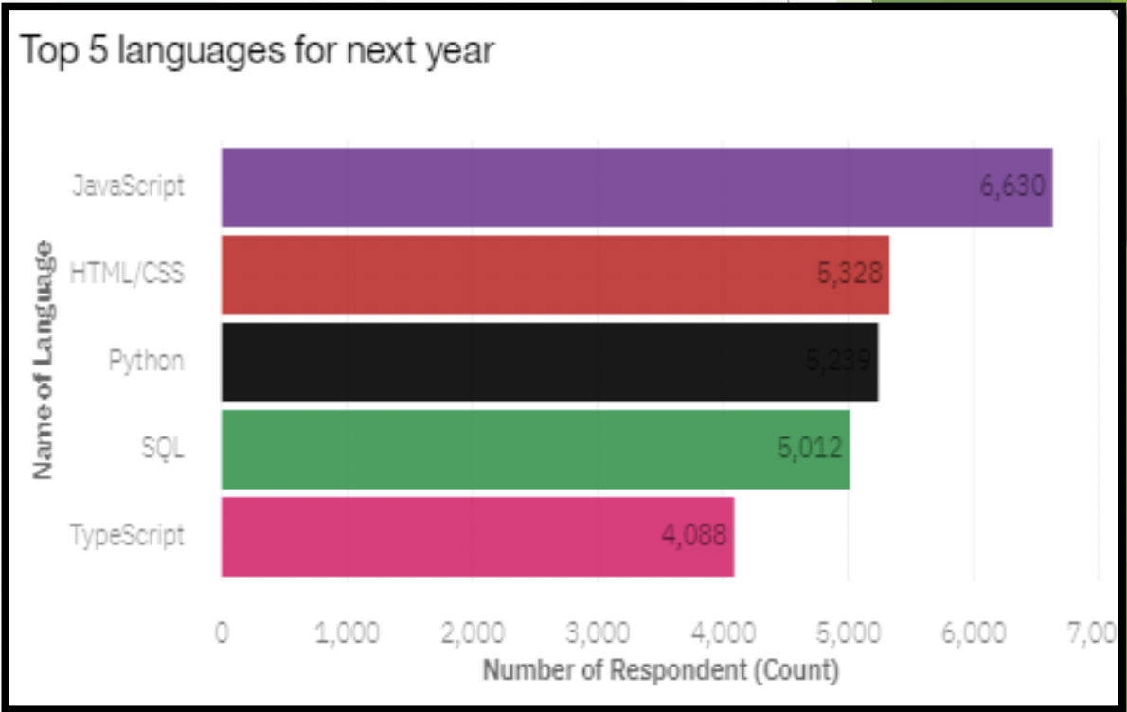
PROGRAMMING LANGUAGE TRENDS
Current Year
Next Year

Slide 7
PROGRAMMING LANGUAGE TRENDS - FINDINGS & IMPLICATIONS
Findings
Top 5 language: Java, HTML, SQL, BASH and Python
Top 5 Language wanted to be learn: Java, HTML, SQL, Python and Typescript
Implications
Most likely, next year:
Java will remain most popular
Python will become more popular
Bash will become less popular

Slide 8
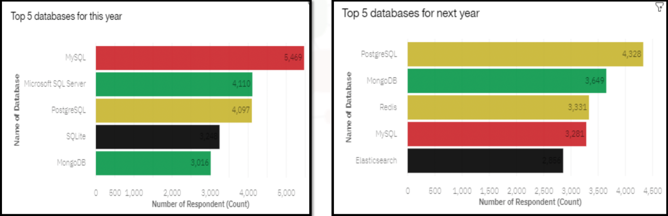
DATABASE TRENDS
Current Year
Next Year

Slide 9
DATABASE TRENDS - FINDINGS & IMPLICATIONS
Findings
Top 5 Database: MYSQL,MS SQL, PostgreSQL and MongoDB
Top 5 Database wanted to be learn:PostgreSQL, MongoDB, Redis, MYSQL and Elasticsearch
Implications
Most likely, next year:
PostgreSQL will remain most popular
MongoDB will become more popular
MySQL will become less popular

Slide 10

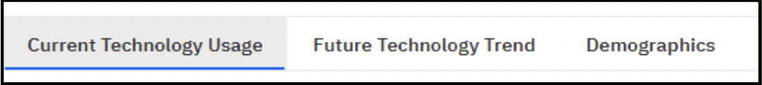
DASHBOARD
The Dashboard consists of three tabs:
For viewing the dashboard please click HERE

Slide 11
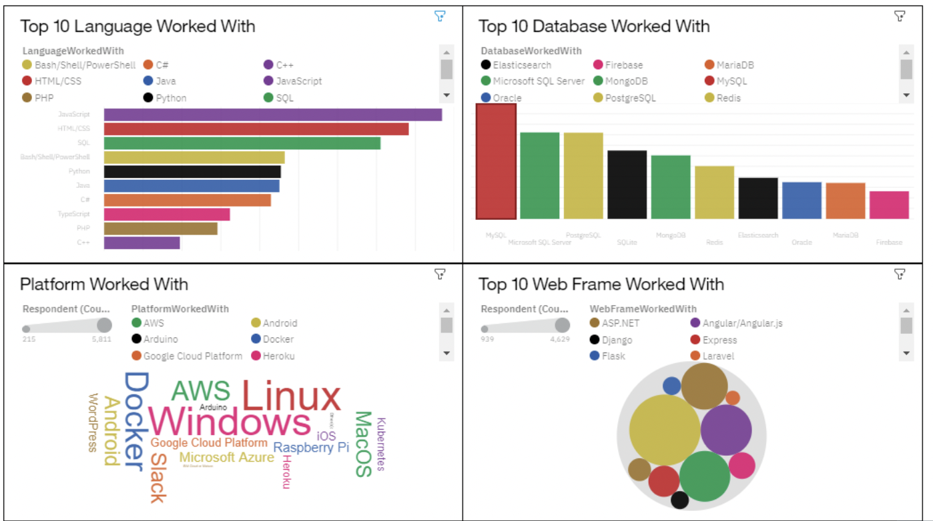
DASHBOARD TAB 1

Slide 12
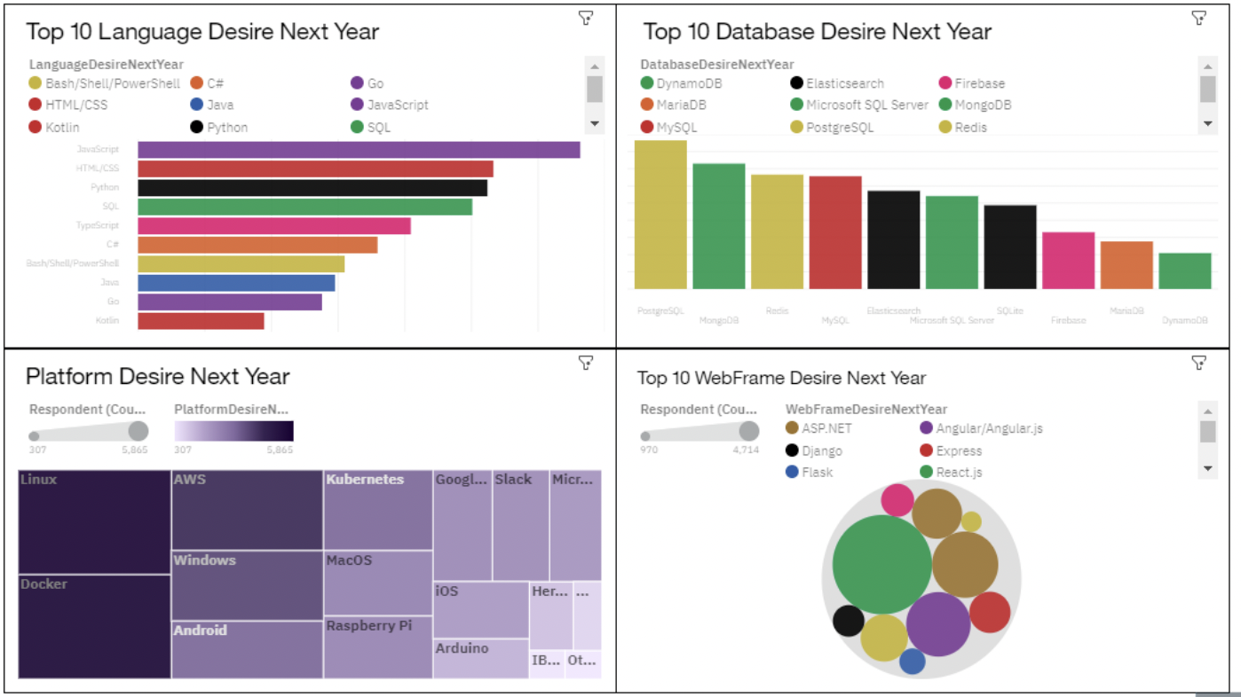
DASHBOARD TAB 2

Slide 13
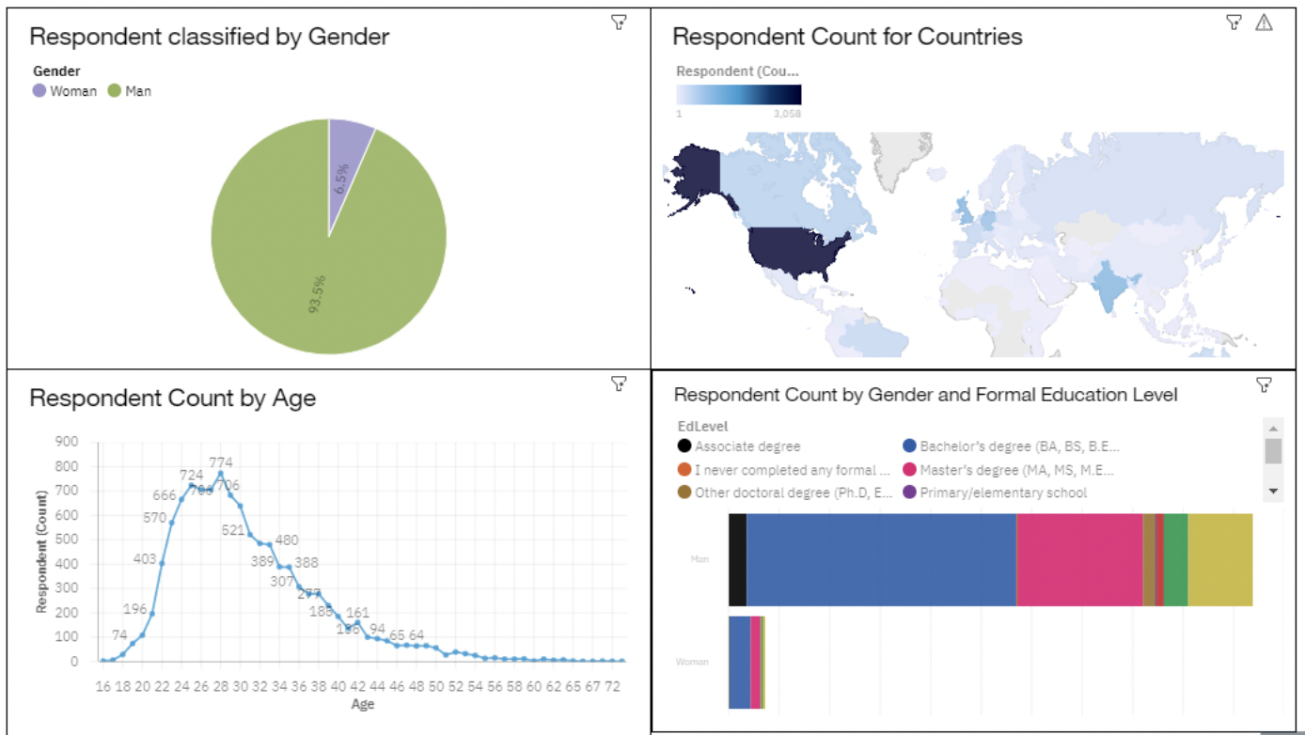
DASHBOARD TAB 3

Slide 14
DISCUSSION
Is python become the most popular languages in near future?
Future of MS SQL Server
Why workplaces is male dominated?

Slide 15
OVERALL FINDINGS & IMPLICATIONS
Findings
Most participant are male
Java is and remain the most popular language for this and next year
Linux continue to gain more share in the market
Implications
PostgreSQL most likely will become the most popular DB in near future
Python can be the rising star of languages

Slide 16

CONCLUSION
SWIFT and Python programmer have higher salary
The developer job market is dominated by males
Age of workforces currently is between 25-30
PostgreSQL become more popular next year

Slide 17
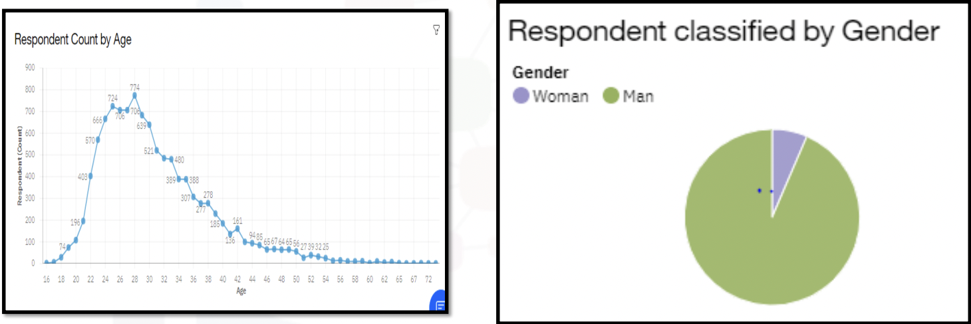

APPENDIX

Slide 18
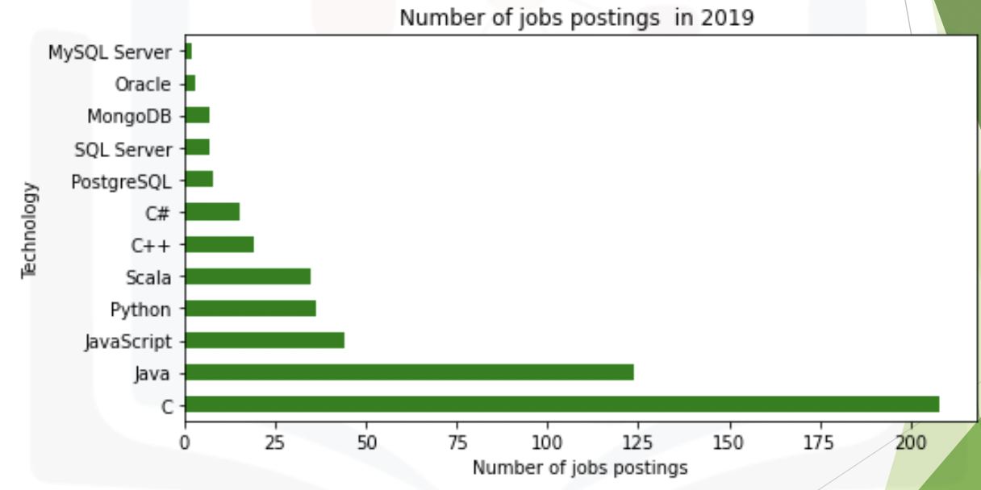
GITHUB JOB POSTINGS

Slide 19
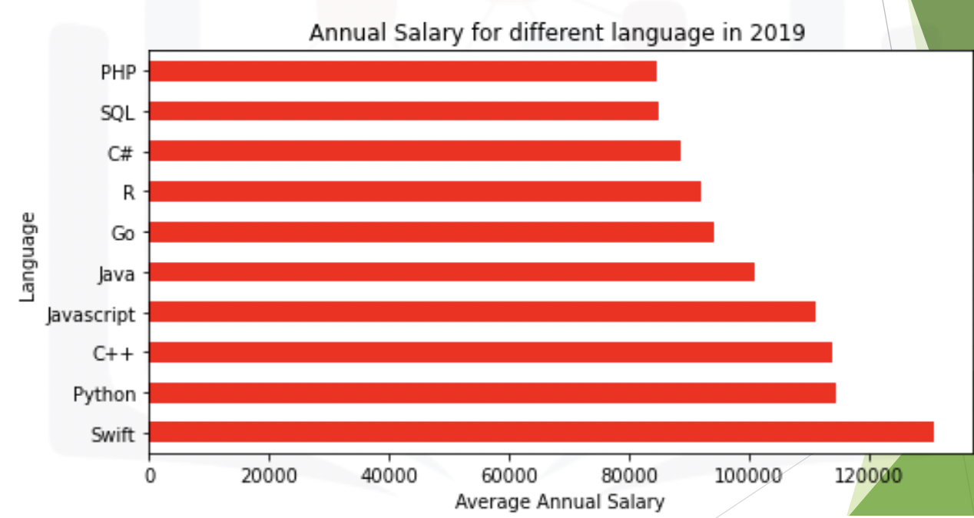
POPULAR LANGUAGES

